Slide 1
Sports screen report generator script map
By: Dan Gregory

Slide 2
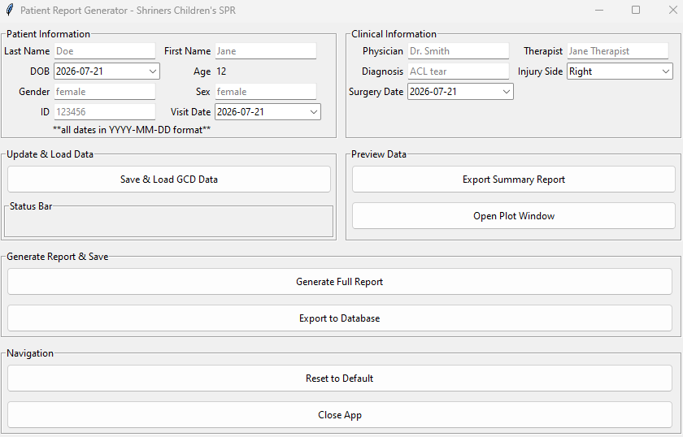
1. Enter patient info
2. Enter clinical info
3. Save patient/clinical info and grab gcd files to load
4. Call to: load_data
4a. Patient info saved via self.patient_data etc. – no function or list used
4b. Call to: load_create_patient_data
*checks for existing folder with patient ID
creates new folder if one doesn’t exist
*checks for existing parquet files
loads all existing data from parquet files including session dates
*returns session_dict – contains session info and full_df
4c. Call to: getData_dialog
*input is session_dict
*checks for overlapping dates
Provides option to add selected data as new visit if date exists – otherwise pulls gcd data
*returns gcd_data and py_data (if py file data exists

